Slide 1
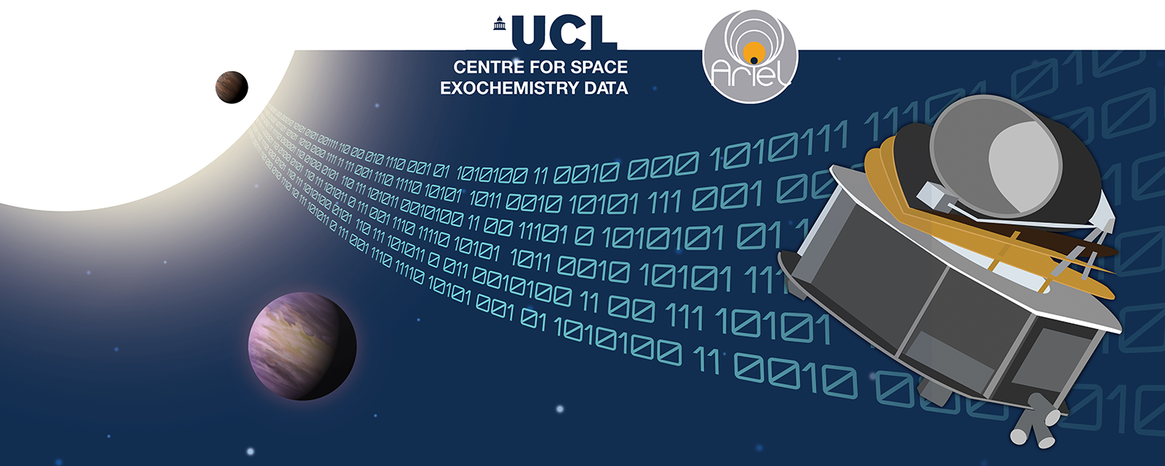
Lecture 1.5: Deep Understanding of Ariel Mission
Tutorials: NeurIPS - Ariel Data Challenge 2024
Presenter: kaggle君-sakura（bili_sakura@zju.edu.cn）
Date: October 8, 2024
Image Credit: NeurIPS - Ariel Data Challenge 2024 | Kaggle
© kaggle君-sakura, 2024. All rights reserved.

Slide 2
Outline
Exoplanetary Science (系外行星科学)
Detection Methods
Direct Imaging (直接成像法)
Transit Methods (凌日法)
Challenges
Noisy Data (噪声数据)
Goal of Ariel Data Challenge
Detrending/Denosing (去趋势/去噪)
Ariel's instruments
© kaggle君-sakura, 2024. All rights reserved.

Slide 3
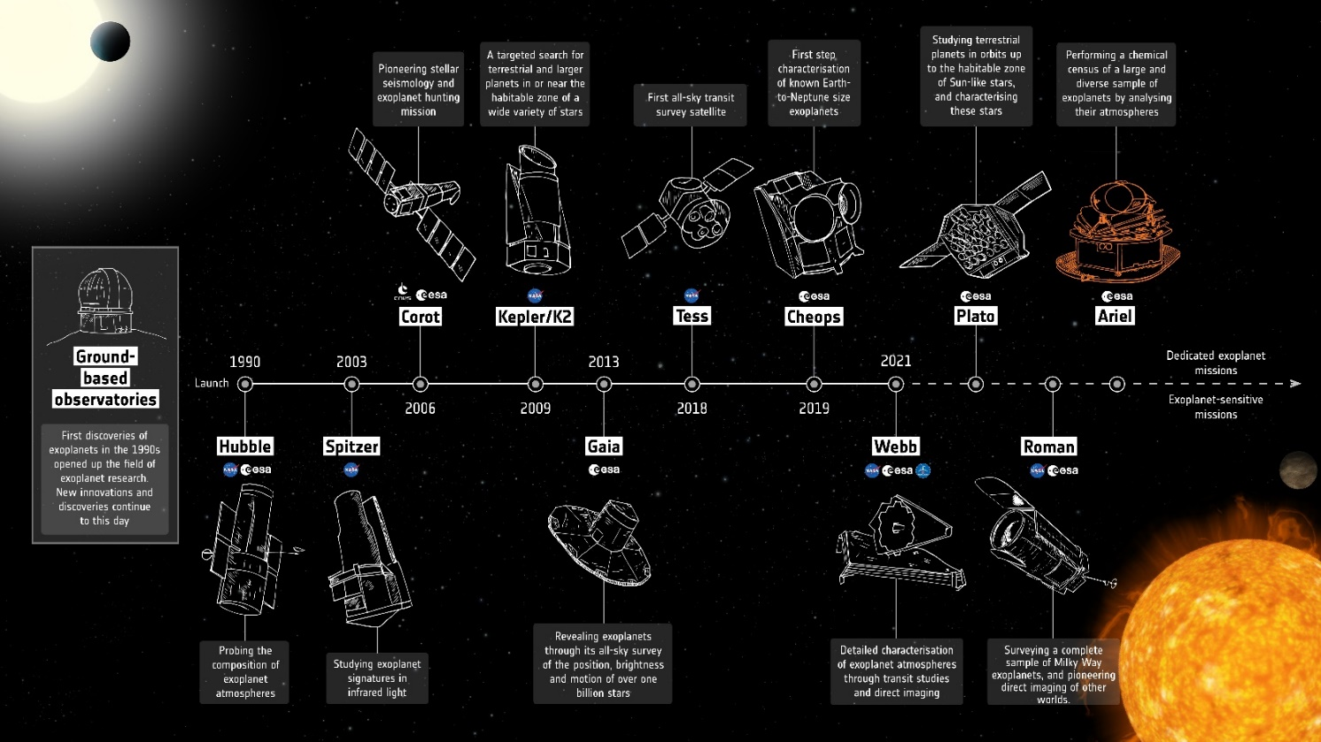
Exoplanetary Science
An exoplanet or extrasolar planet is a planet outside the Solar System.
(Importance) Exploring whether these planets could support life, understanding their atmospheres, and learning about the diversity of planetary systems in our galaxy.
Four exoplanets of the HR 8799 system imaged by the W. M. Keck Observatory over the course of seven years. Motion is interpolated from annual observations.
ESA Exoplanet Mission Timeline
https://en.wikipedia.org/wiki/Exoplanet
https://www.esa.int/Science_Exploration/Space_Science/Ariel_factsheet
© kaggle君-sakura, 2024. All rights reserved.

Slide 4
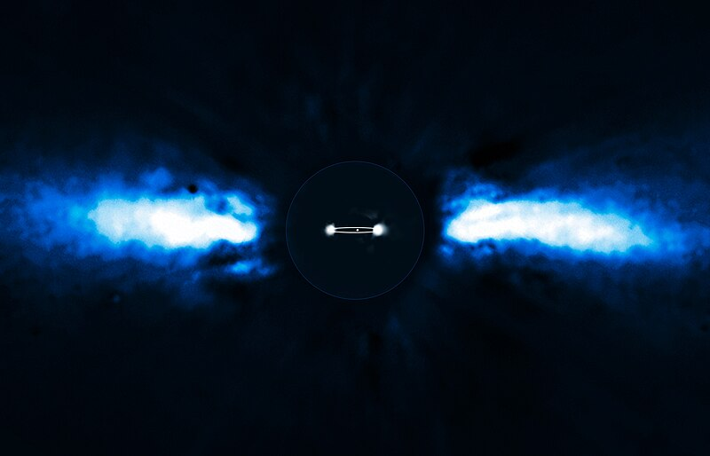
Detection - Direct Imaging
Direct imaging of exoplanets is challenging because planets are extremely faint compared to their parent stars, often a billion times dimmer. The glare from the star tends to overpower the planet’s light, requiring techniques to block the star's light and isolate the planet. This method has only been successful for large planets, more massive than Jupiter, that are far from their parent stars due to the technical difficulty of achieving the necessary optothermal stability. 系外行星的直接成像具有挑战性，因为与它们的母星相比，行星非常暗淡，通常暗 10 亿倍。来自恒星的眩光往往会压倒行星的光线，需要技术来阻挡恒星的光线并隔离行星。这种方法只对质量比木星更大的大型行星成功，由于实现必要的光热稳定性的技术难度，这些行星远离它们的母星。
Directly imaged planet Beta Pictoris b
https://en.wikipedia.org/wiki/Exoplanet#Direct_imaging
© kaggle君-sakura, 2024. All rights reserved.

Slide 5
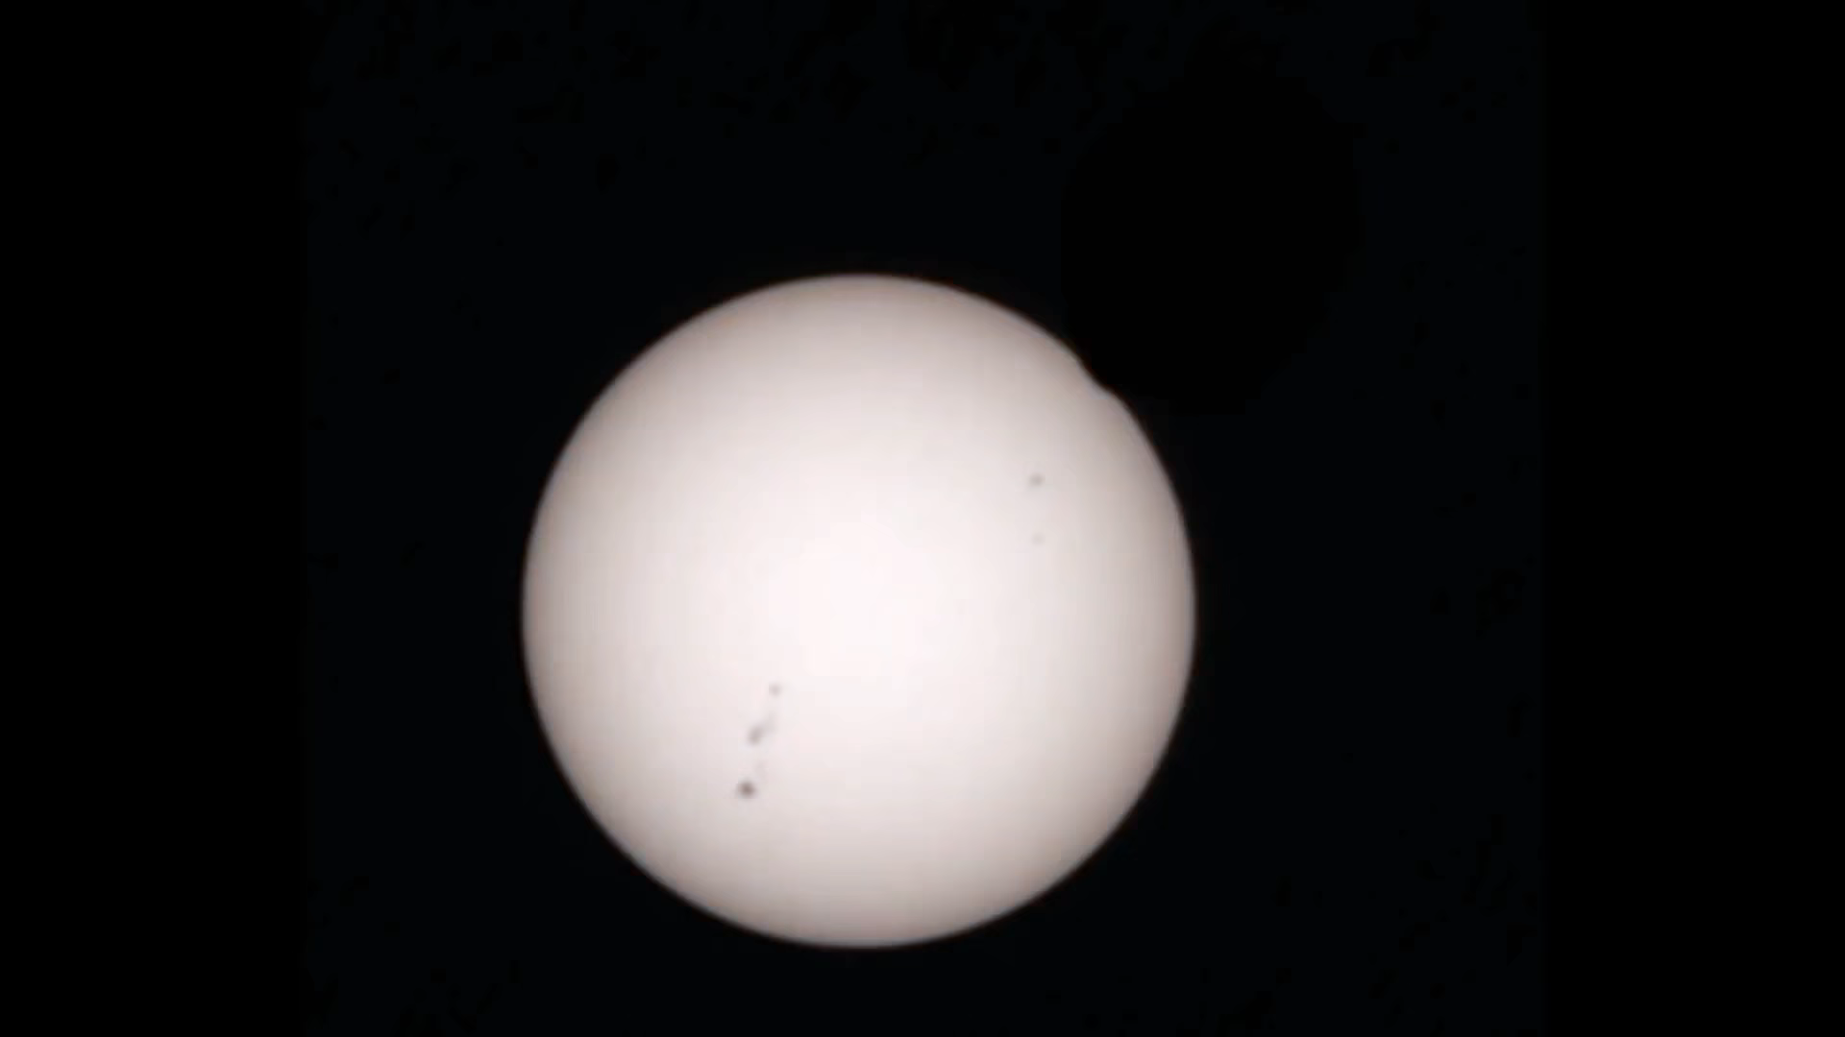
Detection - Transit Methods
In astronomy, a transit (or astronomical transit) is the passage of a celestial body directly between a larger body and the observer. As viewed from a particular vantage point, the transiting body appears to move across the face of the larger body, covering a small portion of it. 在天文学中，凌日（或天文凌日）是天体在较大天体和观察者之间的直接通过。从特定的有利位置看，凌日天体似乎在较大天体的表面移动，覆盖了它的一小部分。
The word "transit" refers to cases where the nearer object appears smaller than the more distant object. Cases where the nearer object appears larger and completely hides the more distant object are known as occultations. “凌日”一词是指较近的天体看起来比较远的天体小的情况。较近的天体看起来更大并完全隐藏较远的天体的情况称为掩星。
However, the probability of seeing a transiting planet is low because it is dependent on the alignment of the three objects in a nearly perfectly straight line.Many parameters of a planet and its parent star can be determined based on the transit. 然而，看到凌日行星的概率很低，因为它取决于三个天体在一条几乎完美的直线上的排列。行星及其母星的许多参数都可以根据凌日来确定。
Phobos transits the Sun, as viewed by the Perseverance rover on 2 April 2022
https://en.wikipedia.org/wiki/Astronomical_transit
© kaggle君-sakura, 2024. All rights reserved.

Slide 6
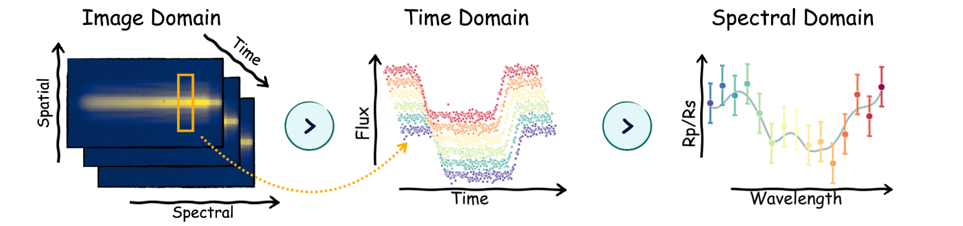
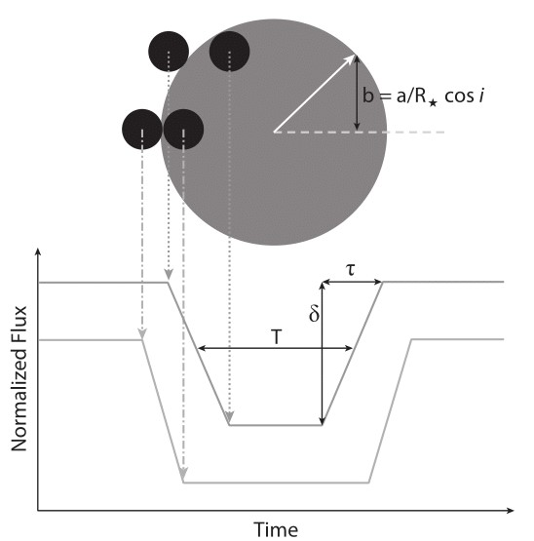
Detection - Transit Methods
The transit method measures the decrease in a star's brightness when a planet crosses in front of it (transits). This drop in brightness, or transit depth (δ), reveals the planet’s radius relative to the star. The transit duration (T) refers to the time the planet spends crossing the star, while the ingress/egress duration (τ) describes the time the planet takes to fully cover and uncover the star. By analyzing these parameters and combining them with radial velocity data, both the planet’s radius and mass can be determined, allowing scientists to calculate key orbital characteristics.
凌日法通过测量当行星经过其母星前方时恒星亮度的下降来确定行星的存在。这种亮度的下降称为凌日深度 (δ)，可以揭示行星相对于恒星的半径。凌日持续时间 (T) 是行星横跨恒星的时间，而进入/离开时间 (τ) 则描述了行星完全遮挡和露出恒星所需的时间。通过分析这些参数，并结合径向速度数据，可以同时确定行星的半径和质量，并计算其轨道特性。
Theoretical transiting exoplanet light curve. This image shows the transit depth (δ), transit duration (T), and ingress/egress duration (τ) of a transiting exoplanet relative to the position that the exoplanet is to the star.
https://en.wikipedia.org/wiki/Methods_of_detecting_exoplanets
© kaggle君-sakura, 2024. All rights reserved.

Slide 7
Noisy Data
Observing these atmospheres is one of the hardest data-analysis problems in contemporary astronomy. When an exoplanet transits its host star in our line of sight, a tiny fraction of starlight (50–200 photons per million) passes through the planet's atmospheric annulus and interacts with its chemistry, clouds, and winds. These faint signals typically range from 50ppm (for Super-Earth like planets) to 200ppm (for Jupiter like planets) in magnitude and are regularly corrupted by the noise of the instrument. A major component of this noise is due to the inevitable vibration of the spacecraft in space, known as ‘jitter noise’. This noise arises from the difficulties of maintaining precise pointing in low-gravity environments, as the spacecraft relies on spinning momentum wheels for stability. Akin to taking long-exposure images with a shaky hand, this noise poses a far greater challenge than the motion blur encountered in commercial photography applications. The photometric variation (∼200 ppm) caused by jitter noise alone is comparable to the variation exhibited by the planetary signal we aim to detect, undermining signals from small planets like Earths and super-Earths. Coupled with other sources of correlated and uncorrelated noises, it is proving difficult for us to achieve the strict technical requirement of the Ariel Payload design.
观察这些大气层是当代天文学中最困难的数据分析问题之一。当一颗系外行星在我们视线范围内凌日时，只有一小部分恒星光（每百万个光子中有 50–200 个）会穿过行星的大气环并与其化学成分、云层和风相互作用。这些微弱信号的幅度通常在 50ppm（类超级地球）到 200ppm（类木星行星）之间，并且经常被仪器噪声破坏。噪声的一个主要组成部分是航天器在太空中的不可避免的振动，称为“抖动噪声”。这种噪声来自于航天器依靠旋转动量轮保持稳定性时在低重力环境中保持精确指向的困难。类似于用抖动的手拍摄长曝光照片，这种噪声比商业摄影应用中遇到的运动模糊挑战更大。单是抖动噪声引起的光度变化（约200 ppm）就足以与我们希望检测的行星信号相媲美，特别是像地球和超级地球这样的小行星信号。这种噪声再加上其他相关和无关的噪声源，给我们达到 Ariel 载荷设计的严格技术要求带来了很大困难。
Further Reading: https://en.wikipedia.org/wiki/Jitter
© kaggle君-sakura, 2024. All rights reserved.

Slide 8
Goal of Ariel Data Challenge
The task of this competition is to extract the atmospheric spectra from each observation, with an estimate of its level of uncertainty. In order to obtain such a spectrum, we require the participant to detrend a large number of sequential 2D images of the spectral focal plane taken over several hours of observing the exoplanet as it eclipses its host star. Performing this detrending process to extract atmospheric spectra and their associated errorbars from raw observational data is a crucial and common prerequisite step for any modern astronomical instrument before the data can undergo scientific analysis.
本次竞赛的任务是从每次观测中提取大气光谱，并估计其不确定性水平。为了获得这种光谱，我们要求参与者对连续数小时观测系外行星凌日时所拍摄的大量 2D 谱焦平面图像进行去趋势处理。执行这种去趋势处理以从原始观测数据中提取大气光谱及其相关误差条，是任何现代天文仪器在数据进行科学分析之前的关键和常见的预处理步骤。
© kaggle君-sakura, 2024. All rights reserved.

Slide 9
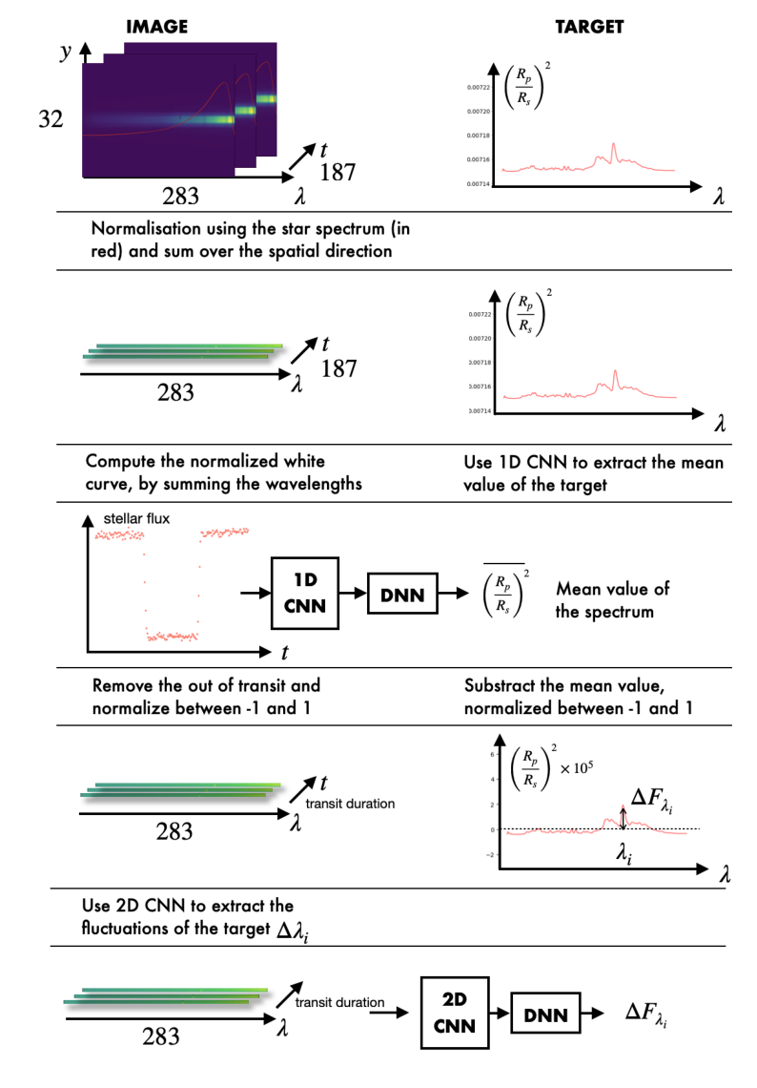
Detrending/Denoising
Note: We will dive into this official solution in lecture 2.
Normalization using the star flux.
White light curve analysis to extract the mean transit depth.
Removal of out-of-transit signals.
Subtracting the mean transit depth to isolate wavelength-dependent variations.
Applying MC Dropout to estimate uncertainty and ensure robustness of the predictions.
在官方提供的解决方法中(baseline)，去趋势通过一系列步骤实现，目的是减少噪声并提取行星凌日信号，便于更准确的光谱预测。主要步骤包括：
归一化处理：首先对数据进行归一化，消除与恒星通量有关的变化。通过用恒星通量（从凌日前后平均获得）除以信号，可以去除与行星凌日无关的长期趋势和系统性变化。
白光曲线（1D CNN）：通过计算白光曲线，提取由整个图像的总通量随时间变化的亮度变化。这一曲线捕捉了恒星亮度变化，并用于1D-CNN模型估计平均凌日深度，从而隔离出与大气层相关的波长变化。
数据预处理：将数据分为凌日和非凌日阶段，并去除非凌日数据，专注于凌日事件本身，消除与凌日无关的信号。
去除平均值以提取光谱特征（2D CNN）：通过减去光谱中的平均凌日深度，保留与行星大气层有关的变化。这一步帮助突出光谱中的细微变化，并使用2D-CNN模型拟合大气特征。
蒙特卡洛丢弃（MC Dropout）：在推理阶段应用MC Dropout来估计预测的不确定性，从而保证去趋势后的数据预测更加准确。
https://www.kaggle.com/code/gordonyip/host-starter-solution
© kaggle君-sakura, 2024. All rights reserved.

Slide 10
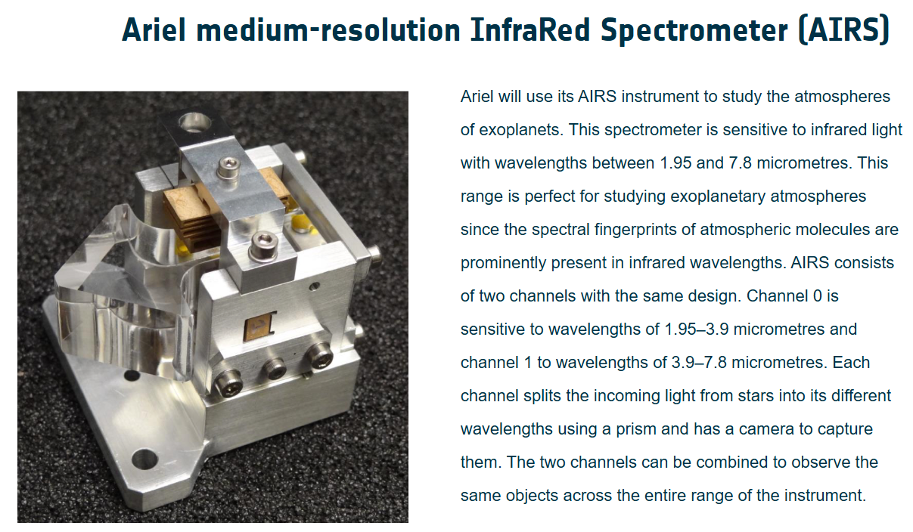
Ariel's Instruments
https://www.esa.int/Science_Exploration/Space_Science/Ariel/Ariel_s_instruments
© kaggle君-sakura, 2024. All rights reserved.

Slide 11
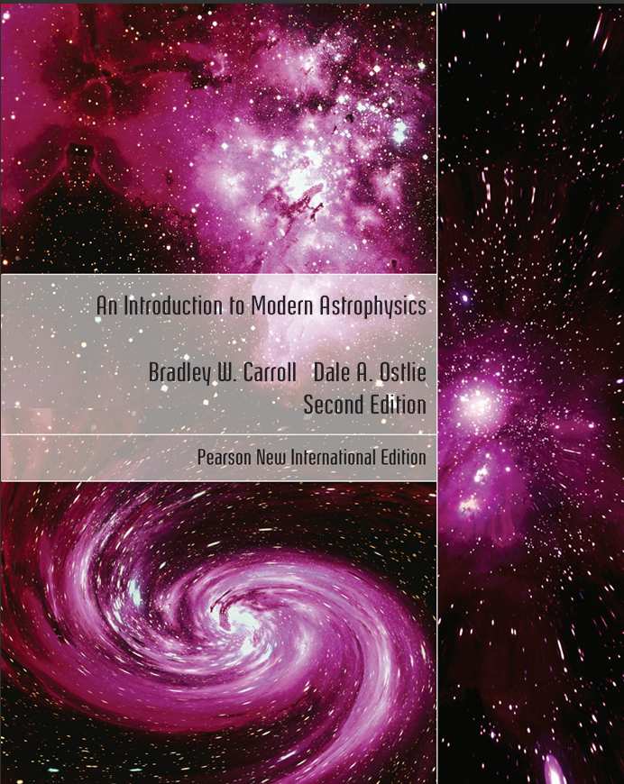
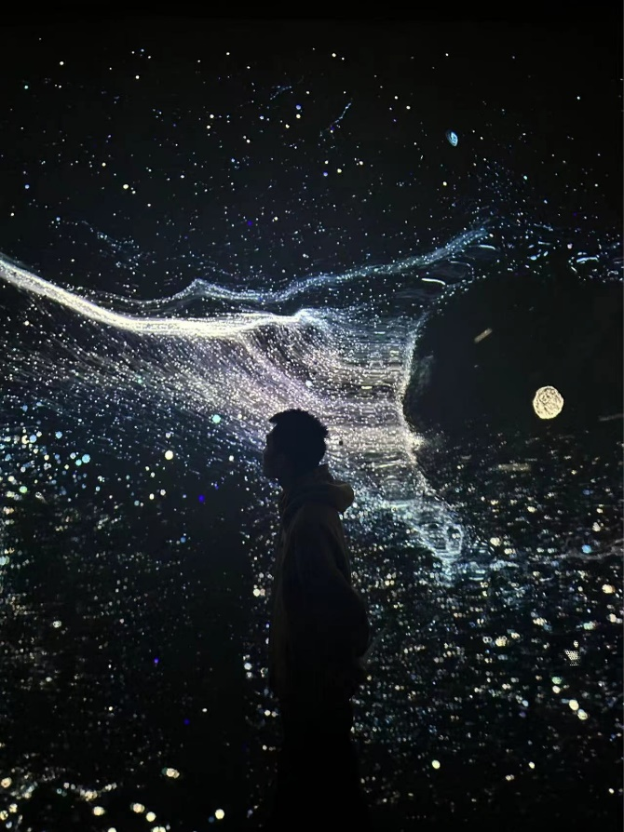
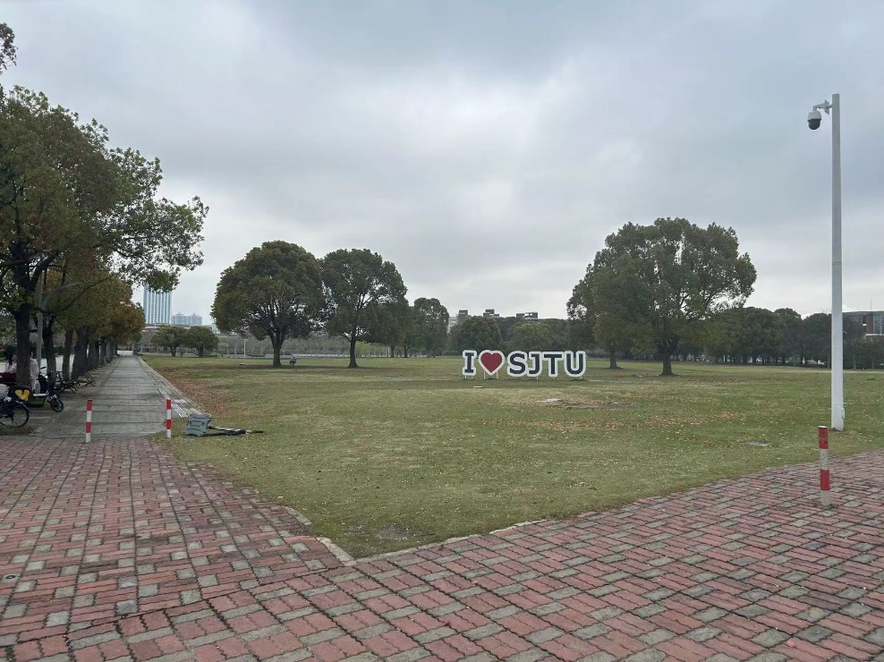
Supplementary
Note: Only if you are interested in astrophysics!
上海交通大学 & 天文学部(sakura于2024.4)
Astrophysics Textbook
上海天文馆 (sakura于2024.5)
Carroll, B. W., & Ostlie, D. A. (2017). An introduction to modern astrophysics. Cambridge University Press.

